Slide 1
A Cybersecurity Framework for Autonomous Drones
Information Assurance CIS6372
David Lelis
N00957151

Slide 2

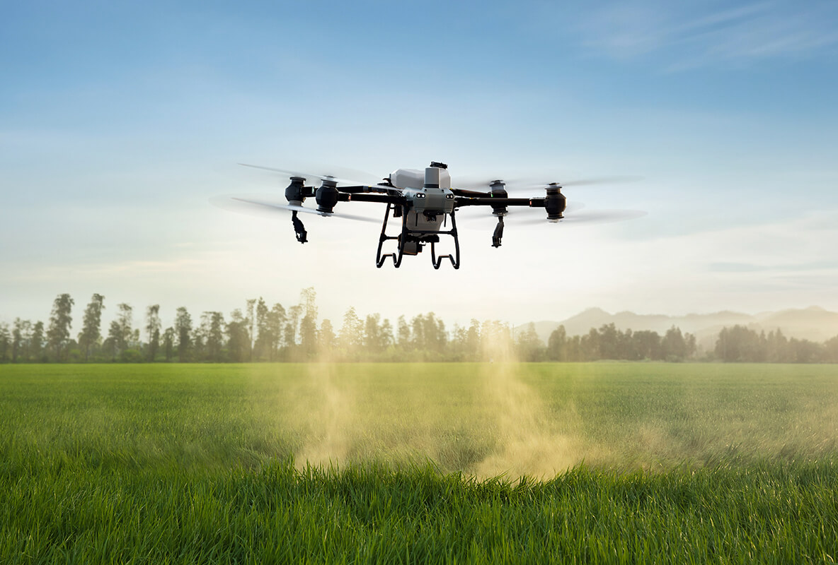
Background Information
Autonomous drones are becoming more common place in regular society, through applications like:
Agriculture
Product Delivery
Surveillance
Emergency First Response
Entertainment
Through these industries, malicious people target drones for their own goals or unexpected situations occur that may disconnect the drone from the original users.

Slide 3
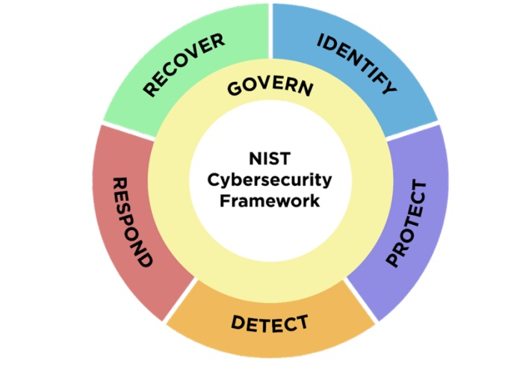
Current Cybersecurity Standards for Drones
There isn’t a universally adopted cybersecurity framework for drones specifically, but most drones follow the NIST Cybersecurity Framework (CSF) 2.0.
Most current points-of-interest in research include:
Secure by Design
Data Protection
Software Updates and Vulnerabilities
Communication Security
Access Control
Physical Security
Threat Modeling

Slide 4

Vulnerabilities and Solutions
Drones are often vulnerable to attacks and unexpected situations like:
Man In the Middle (MITM) data interception
Signal Jammers like Denial-of-Service (DoS)
Disconnection from the host server
This study proposes the following framework as a standard for defense against attacks
End-to-End (E2E) Encryption
DoS detection and defense
Failsafe Mechanisms

Slide 5
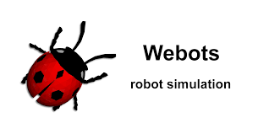
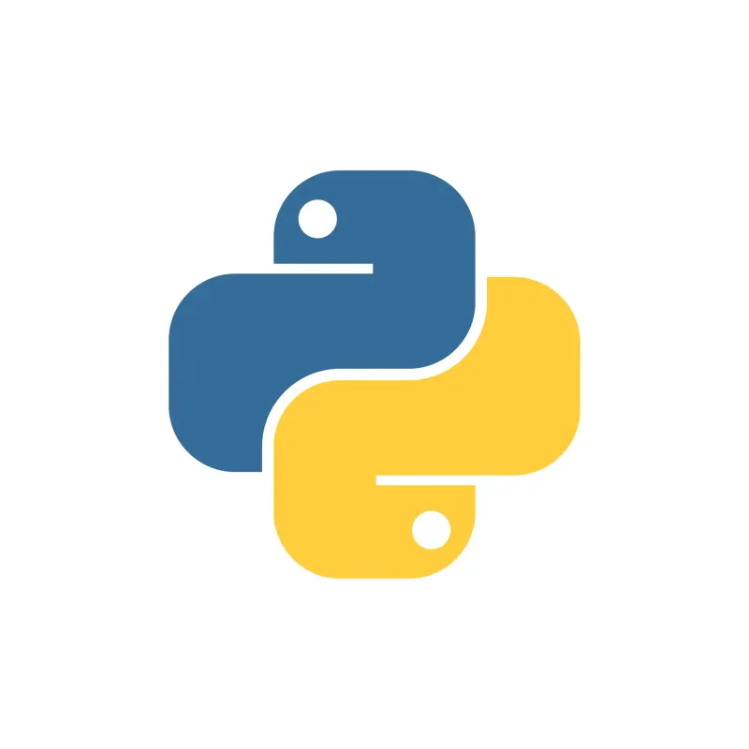
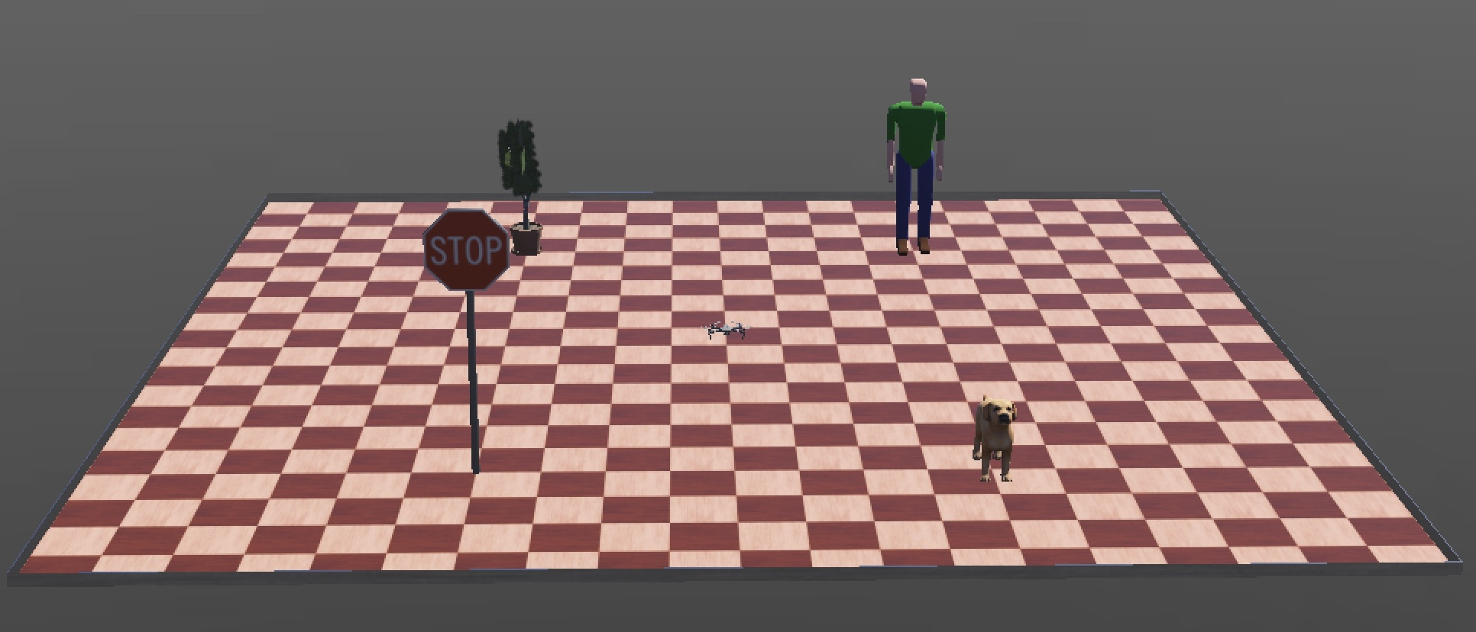
Simulation Objectives
The simulation was built from Webots and utilized Python and its libraries to create client-server programs, along with other programs to simulate cyberattacks.
The drone is tasked to move to four points in the 10m x 10m environment.
Cyberattacks and situations will run along side with the simulation, where the client or server may respond to defend.

Slide 6

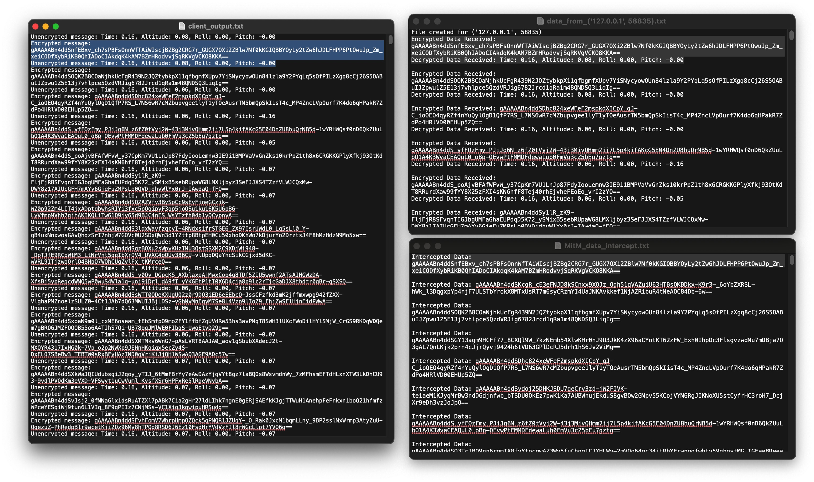
MITM Data Interception & E2E Encryption
Attackers target drones to intercept data for their own personal gain.
MITM Data Interception is where an attacker disguises their server as the original host server and passes information between a client-drone and the server to gather private, confidential data.
A solution for this would be to implement E2E Encryption that would alter the data to scramble the data based on a key that only the host server and client have.
Results: An encrypted message that is still intercepted but unreadable.

Slide 7
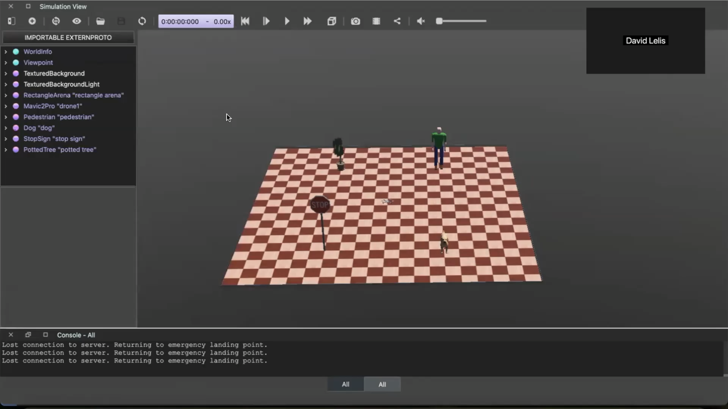
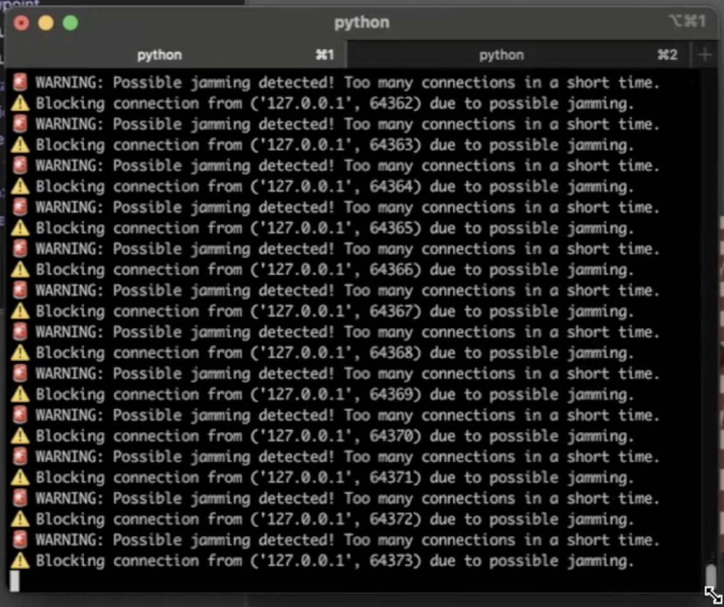
Signal Jamming via DoS attacks & Detection/Firewalls
Signal Jammers are a form of attack that can target a server to disrupt operations for numerous malicious reason.
Often in known as DoS, these are done by sending a large amount of traffic/connections to a server.
A solution is to detect and setting up firewalls to block or even just limit these signals addresses from connecting back to the server again.
Result: Detects and blocks all non-drone clients.

Slide 8
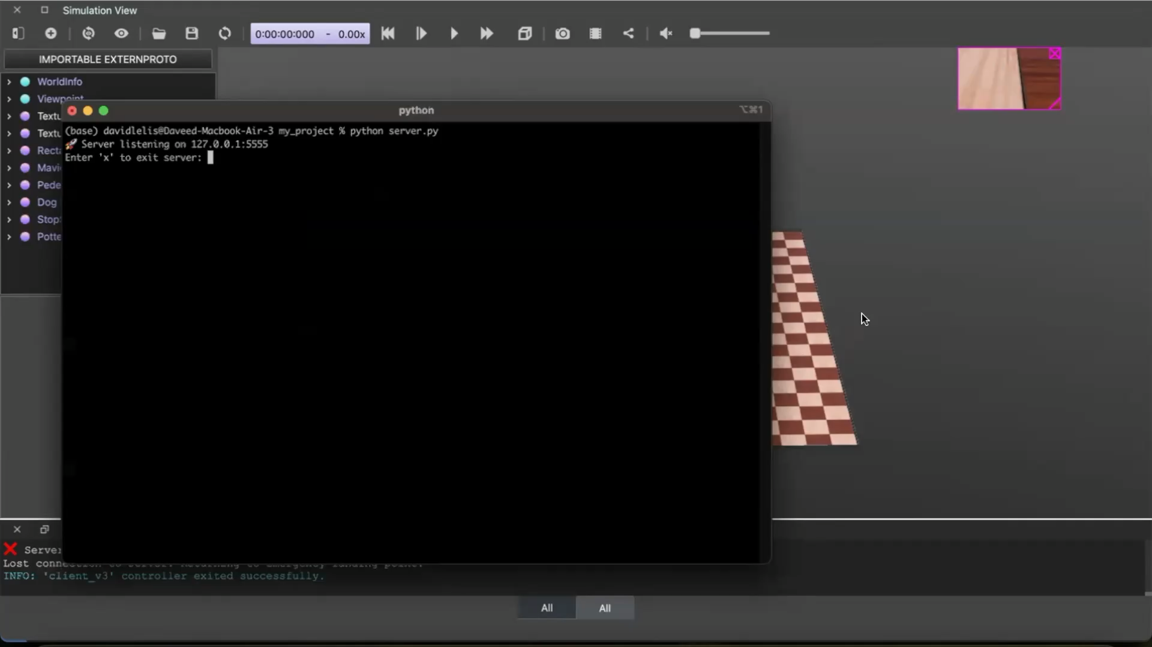
Disconnections & Failsafe Mechanisms
As drones are used remotely, it’s easy for them to disconnect from the original server via flying out of range of the signal or a hiccup in the connection, but it’s also easy for attackers to override and take control of the drone.
Failsafe mechanisms to safely return the drone to its original user should be implemented for the safety of both the environment, any bystanders, and the drone itself.
Results: A routine that successfully returned the drone to its home location.

Slide 9

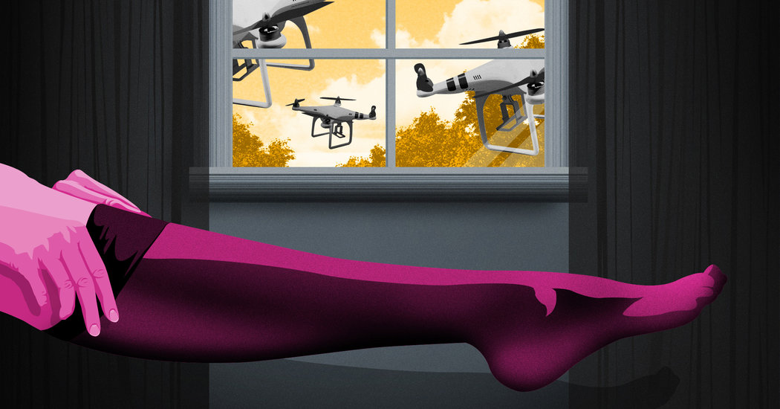
Future research
This study only practiced to defend against three of numerous types of cyberthreats, remaining includes:
Communication Security
Access Control
Physical Security
Threat Modeling
Possible defenses could be a drone-specific verification like a username/password, collision avoidance, and geotag devices.
There is also a matter of malicious uses of drones:
Arming drones with firearms or biological weapons
Nonconsensual surveillance or spying
Suicidal Drones
Defenses against these uses should be done on a governmental scale, as it’s difficult to prevent them.

